Slide 1
Class and OOPS in JAVA

Slide 2
Agenda
Class
Object
Inheritance
Interface
24/05/2021
Basic Java
2

Slide 3
Object

Slide 4
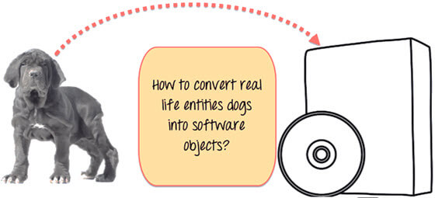
Object
Objects are often used to model real-world objects you find in everyday life.

Slide 5
Class

Slide 6
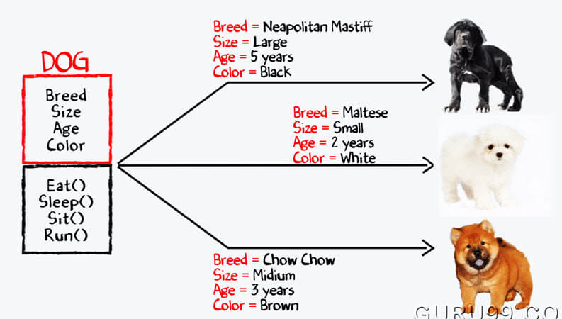
Class
Class is an entity having properties which is common among objects.
As you can see in diagram, class Dog carries common properties for all types of dogs.

Slide 7
Inheritance

Slide 8
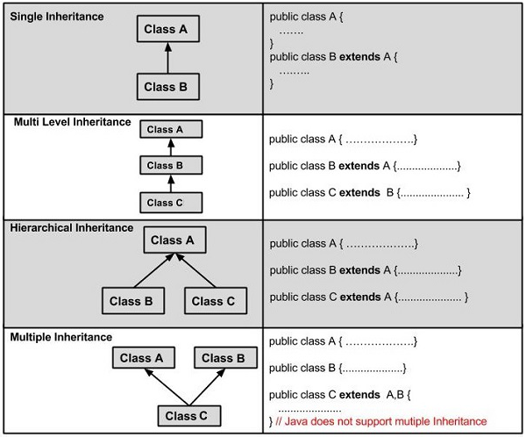
Inheritance
Inheritance is a mechanism in which one object acquires all the properties and behaviors of a parent object.
In order to inherit the parent class properties, the child class has to use keyword ‘extends’.

Slide 9
Interface

Slide 10
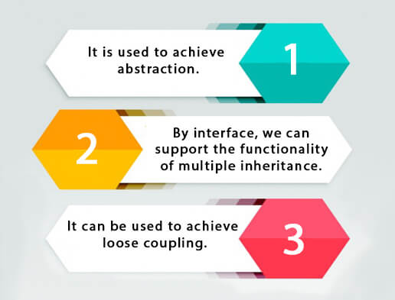
Interface
Interface is a collection of abstract methods.
It is also called as blueprint of a class.
To inherit interface, the child class has to use ‘implement’.
All abstract method must be override by child class.

Slide 11
Thank you

